Slide 1
Historic Spot + ancillary services model

Slide 2
overview
Purpose:
The goal of this model is to estimate how much and how, a portfolio of technologies can create value by participating in the spot and ancillary power markets.
Execution:
A numerical model has been developed, capable of investing in a portfolio of technologies
The model configures the portfolio such that profit is maximized
Historical market data is used

Slide 3
Overview
Spot marked
Tarif 394 [DKK/MWh]
mFRR (opregulering)
Portefølje
Tarif 4 [DKK/MWh]
Generatorer
aFRR (symetrisk op og ned)
FCR (op/ned-regulering)
Lager
Power to X/ Fleksibel forbrug
Specialregulering (nedregulering)
Sekundære markeder
(Brint og fjernvarme)

Slide 4
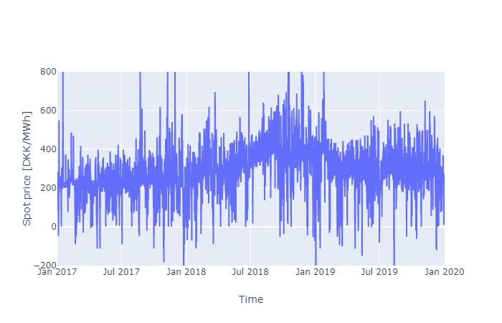
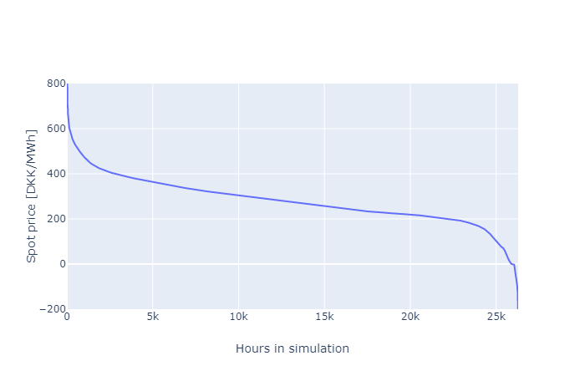
Spot market
The spot market is where the majority of electric power is sold. The market closes at 12:00 the day before the hour of delivery.
The average spot price is around 200 DKK/MWh but fluctuating between -200 DKK/MWh and 800 DKK/MWh
When selling energy the spot market a TSO tariff of 4 DKK/MWh is paid.
When purchasing energy from the spot market a TSO tariff of 94 DKK/MWH is paid + a DSO tariff of 300 DKK/MWH. DSO tariff varies depending on the used DSO.

Slide 5
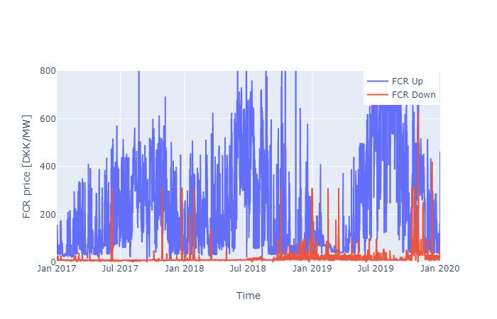
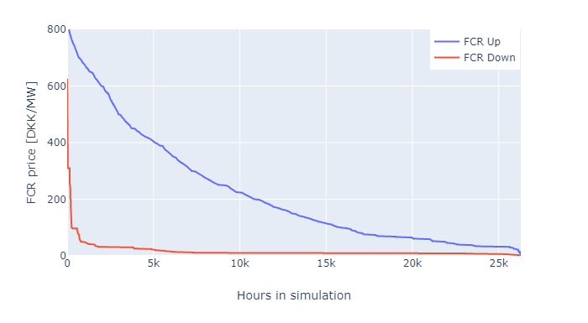
Fcr market
The FCR (frequency containment reserve), also know as primary reserve, is the fastest ancillary service purchased by EnergiNet. This service is responsible for keeping the net frequency between 50.1-49.9 Hz.
Units providing FCR has to deliver regulation within 15sec, and must be capable of staying active for 15 min, until aFRR takes over
In DK1 FCR is purchased separately for Up and Down regulation. In DK2 it is a symmetric product.
There is a requirement on minimum 4 hours of commitment with the same capacity
In DK1 a total of 20MW up and down regulation capacity is purchased in the majority of hours

Slide 6
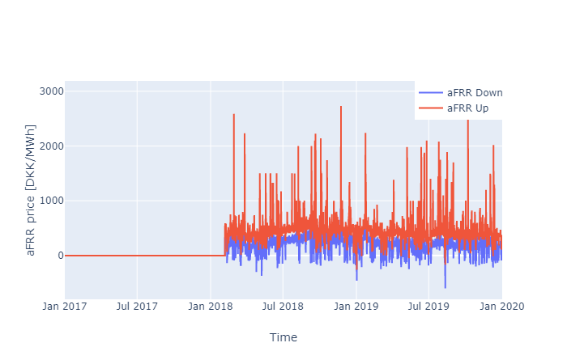
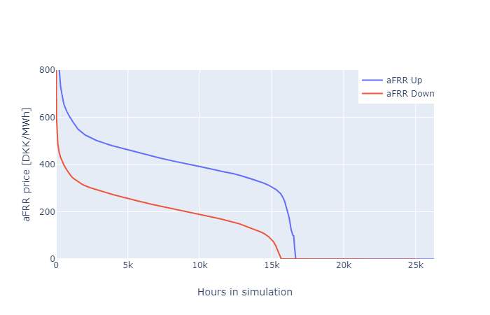
Afrr market
aFRR (automatic frequency restoration reserve), also known as secondary reserves, is responsible for stabilizing the net frequency when FCR capacity has been activated for too long (15 min).
Units delivering aFRR must be capable of activating within 15 minutes.
When participating in the aFRR market a payment is received for the regulating power made available plus a payment for the regulated energy.
The aFRR product is symmetric in DK1.
aFRR is purchased on monthly contracts, requiring commitment for the entire month.

Slide 7
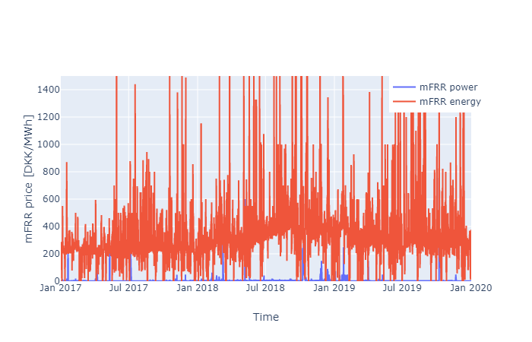
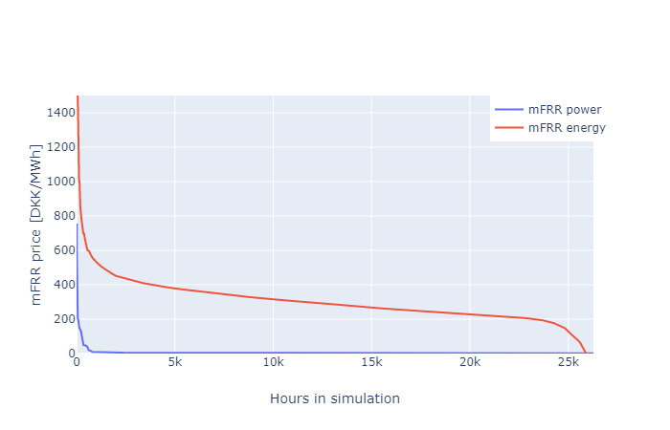
Mfrr market
The mFRR (manual frequency restoration reserve) market, also referred to as tertiary reserves, is the slowest ancillary service purchased by EnergiNet. mFRR is activated to free up aFRR. mFRR is used to balance the market over longer periods of time e.g. in the case of power plant failure etc.
Units participating in the mFRR market must be capable of activating within 15 minutes
Payment is received for regulating power made available, plus for the regulated energy.
mFRR is only purchased as up regulation

Slide 8
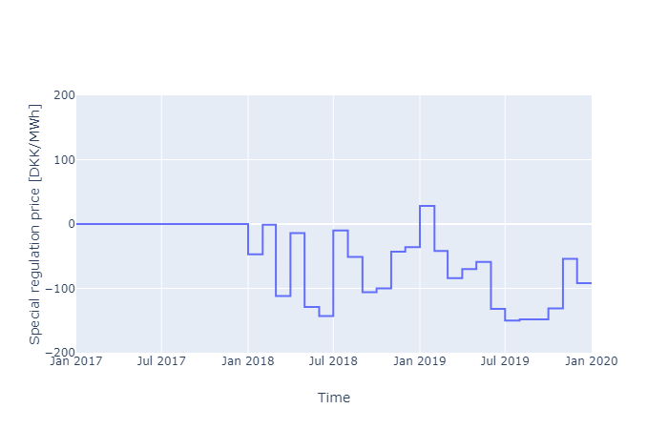
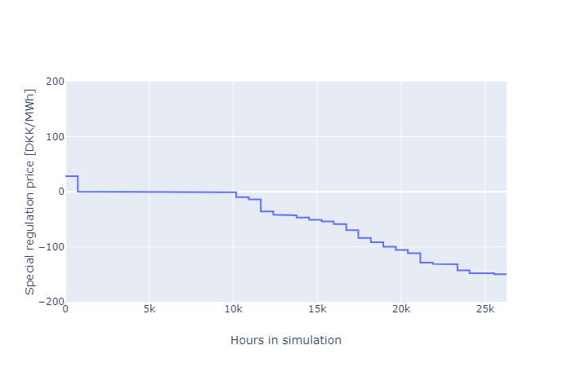
Special regulation
Special regulation is an alternative to mFRR, purchased when technical challenges in stabilizing the electricity grid occurs. The primary reason for the purchase of special regulation in DK1 is a result of overproduction from wind turbines in northern Germany, combined with bottlenecks in the German electricity grid.
Special regulation is primarily purchased as down regulation.
Payment is received only for the regulated energy.
Special regulation is not purchased in all hours of the year.

Slide 9
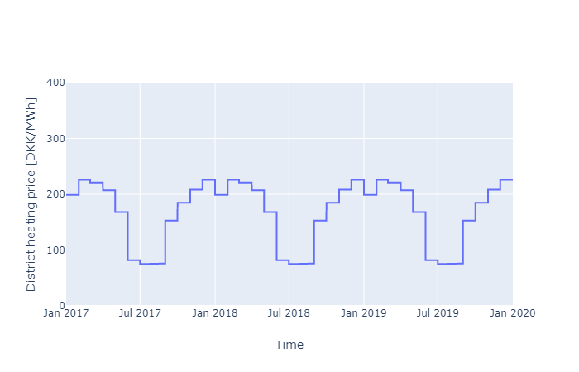
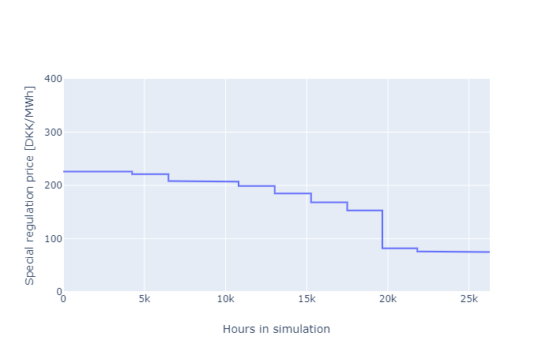
Secondary markets
In this model, the hydrogen and district heating markets are considered as secondary markets.
The district heating price is provided by Århus affald/varme for 2020, and is used for all simulated years.
The hydrogen price is calculated as the price of producing hydrogen with an electrolyzer plant in the 6000 cheapest hours of the year. An efficiency of 100 kW el/kg hydrogen is used. The hydrogen price is kept fixed during the entire simulation.

Slide 10
Results – Individual technologies
In the first study the individual technologies was investigated.
The study seeks to investigate how the individual technologies participate in the different power markets, and how much profit can be made.
A simulation across three years (2017, 2018, 2019) is performed.

Slide 11
Results – Individual technologies
[1000 DKK/MW/year] | Investment | Spot market earnings | Ancillary services markets earnings | Secondary market earnings
Wind turbines | 545 | 386 | 262 | 0
Solar PV | 188 | 184 | 120 | 0
Electric Boiler | 33 | -424 | 571 | 70
Electrolyzer | 470 | -4.391 | 1.886 | 4.194
Battery | 284 | 140 | 2.293 | 0

Slide 12
Results – Individual technologies
[1000 DKK/MW/year] | Spot | FCR up | FCR down | aFRR | mFRR | Special reg
Wind turbines | 386 | 216 | 26 | 0 | 18 | 3
Solar PV | 184 | 101 | 4 | 0 | 14 | 1
Electric Boiler | -424 | 381 | 140 | 0 | 50 | 0
Electrolyzer | -4.391 | 1.779 | 38 | 0 | 53 | 15
Battery | 140 | 1.881 | 133 | 0 | 279 | 0

Slide 13
Results – Portfolio
In this study a portfolio containing technologies already available to EnergiDanmark, has been composed.
This study seeks to investigate how this portfolio participates across the power markets
Wind turbines | Solar PV | Electric Boiler
3 MW | 3 MW | 1 MW

Slide 14
Results – Portfolio
[1000 DKK/MW/year] | Investment | Spot market earnings | Ancillary services markets earnings | Secondary market earnings
 | 2.232 | 778 | 2.108 | 719
[1000 DKK/MW/year] | Spot | FCR up | FCR down | aFRR | mFRR | Special reg
 | 778 | 1.711 | 187 | 0 | 192 | 18

Slide 15
Further work
Include demand response in the model
Investigate synergies between technologies

